Slide 1


Teams
Mic Control
A technical overview of building a robust Python GUI for Windows Audio Control using Kivy and Pycaw.

Slide 2


The Project Goal
Control at Your Fingertips
•
Global Hotkeys: Control microphone volume from anywhere in Windows without opening menus.
•
Visual Feedback: A clean GUI to see current volume and mute status instantly.
•
Key Functions:
○
Ctrl+Alt+Up : Increase Volume
○
Ctrl+Alt+Down : Decrease Volume
○
Ctrl+Alt+M : Toggle Mute

Slide 3


Implementation: Professional GUI
Kivy Integration
We moved from a simple console script to a robust Kivy Application.
•
KV Language: Used for separating logic from design, allowing for a clean "Dark Slate" theme.
•
Reactive UI: The Progress Bar and Labels update automatically via a Clock.schedule_interval.
•
Status Indicators: Text turns Red when Muted and Blue when Active.

Slide 4







Deep Dive: Thread Safety
Main Thread (GUI)
Background (Hotkeys)
Stability
Handles the Visuals. It uses the Cached Interface to read volume safely without initializing COM repeatedly.
Hotkeys run on separate threads. We used a custom decorator @ensure_com_thread to handle their specific memory lifecycle.
This separation ensures that if a hotkey gets stuck, it doesn't freeze the GUI, and vice versa.

Slide 5


Key Functionalities
Volume Logic
Mute Toggle
We read the scalar volume (0.0 to 1.0) and convert it to percentage.
A simple boolean flip operation.
•
Get vol.GetMute()
•
Get Current Volume
•
New State = NOT Old State
•
Add/Subtract Step (5%)
•
Set Mute (1 or 0)
•
Clamp value between 0% and 100%
•
Update GUI Color to Red/Blue
•
Set new Scalar Volume

Slide 6
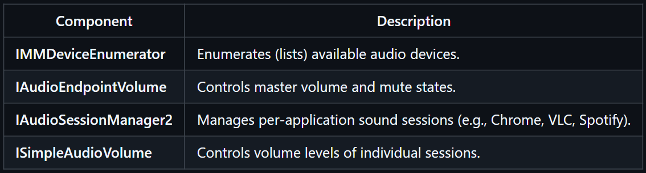
Constant | Meaning | Value
eRender | speakers/headphones (output) | 0
eCapture | microphone (input) | 1
Windows core APIs

Slide 7
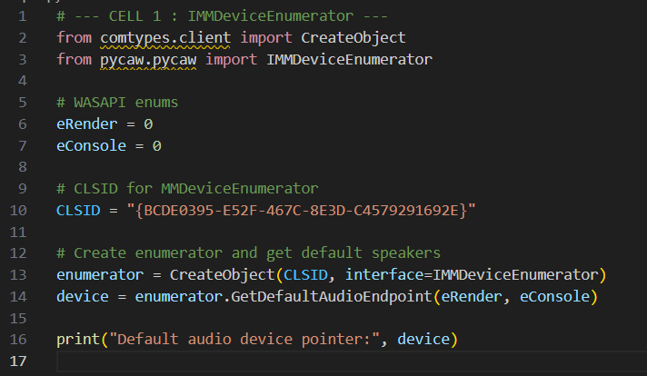

Slide 8
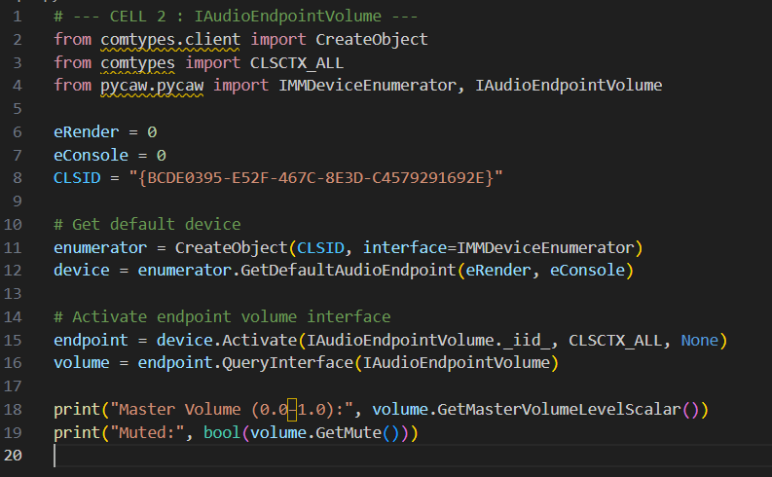
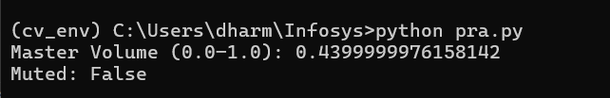

Slide 9
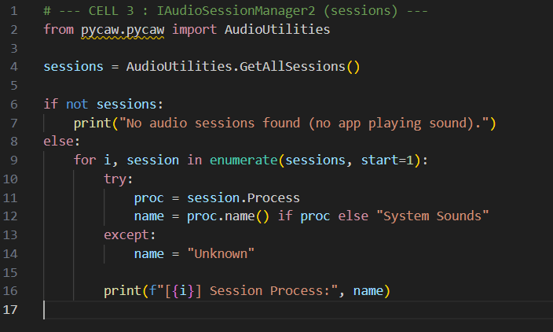
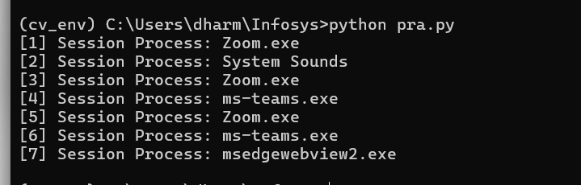

Slide 10
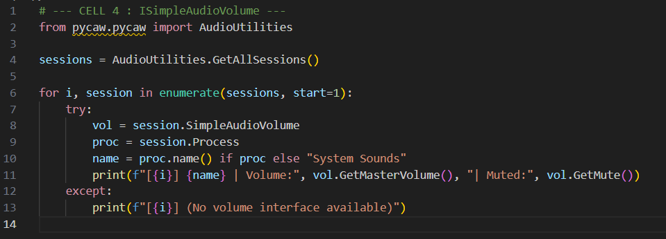
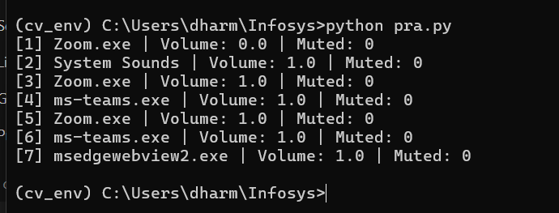

Slide 11
raw = default_device.Activate(...)
volume = cast(raw, POINTER(IAudioEndpointVolume))
SetMasterVolumeLevelScalar()
GetMasterVolumeLevelScalar()
GetMute()
SetMute()
volume.GetMasterVolumeLevelScalar()
volume.SetMasterVolumeLevelScalar()
volume.GetMute()
volume.SetMute()

Slide 12
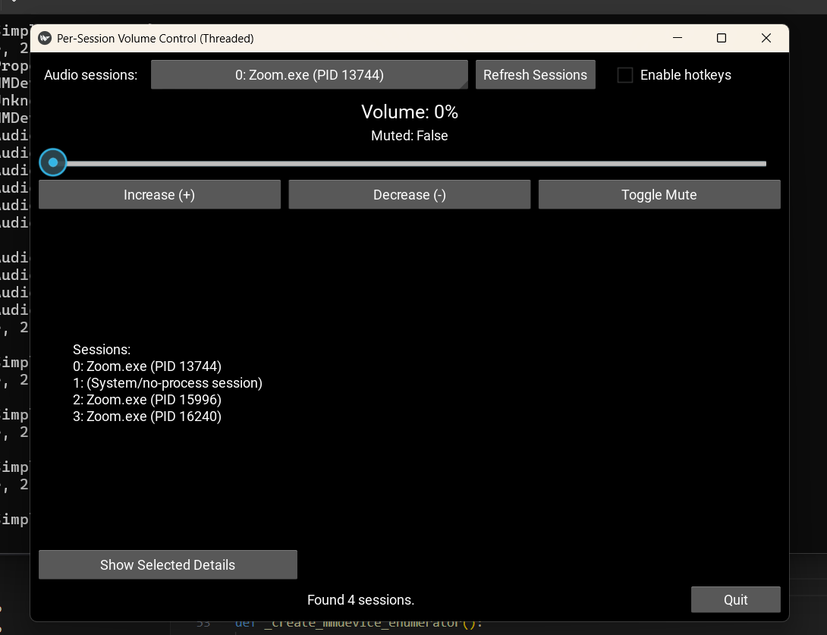

Slide 13
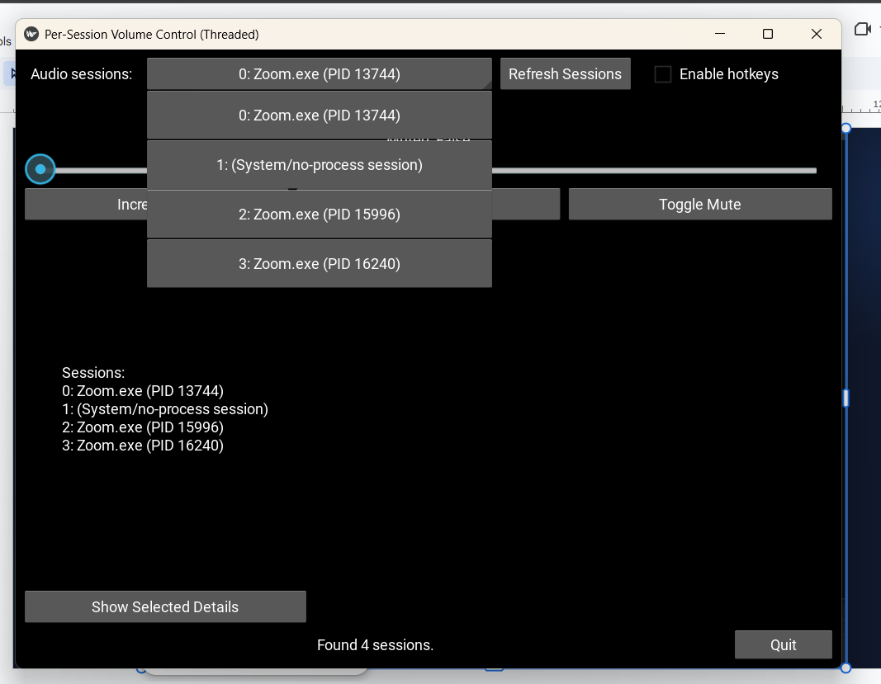

Slide 14
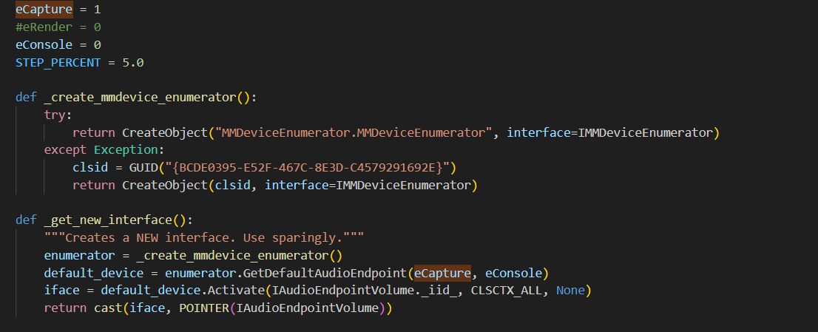

Slide 15
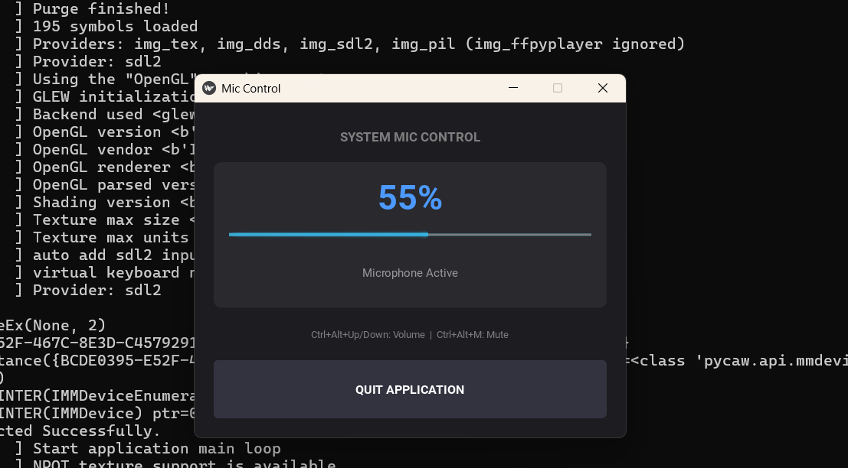

Slide 16
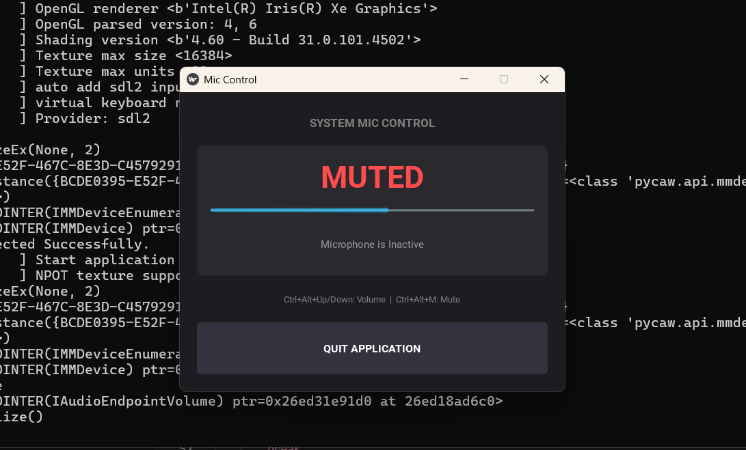

Slide 17
Thank You

